Slide 1
DEERING PARK INNOVATION CENTER - NEW SMYRNA BEACH
Commission Workshop
March 25, 2025

Slide 2
DEERING PARK INNOVATION CENTER PUD MASTER DEVELOPMENT AGREEMENT
Proposed Deering Park PUD is consistent with the New Smyrna Beach Comprehensive Plan designation of Industrial Mixed Use.
The Deering Park PUD Master Development Agreement is a contract between the landowner and the City with strong requirements and written obligations to accomplish the City goals.
The agreements contained in the PUD Master Development Agreement will continue as requirements for the property regardless of any ownership.

Slide 3
DEERING PARK INNOVATION CENTER PUD MASTER DEVELOPMENT AGREEMENT
GOAL: INCREASE THE NON-RESIDENTIAL TAX BASE TO RELIEVE TAX BURDEN ON RESIDENTS
PUD requires a half million sq. ft. of non- residential projects to be constructed and another half million sq. ft. of non-residential projects to be permitted before a single residential home is built.
Upon build out, this one project will increase non-residential tax valuations by approximately 2.7 billion dollars and adjust tax revenues from 83% residential to 63% residential.

Slide 4
DEERING PARK INNOVATION CENTER PUD MASTER DEVELOPMENT AGREEMENT
GOAL: PROVIDE STORMWATER RESILIENCY STANDARDS TO PROTECT NEIGHBORHOODS FROM FLOODING.
PUD requires a comprehensive stormwater system for the entirety of the 1600+ acre parcel.
PUD provides that extensive regional studies and design will be conducted to redirect massive, hurricane level stormwater away from residential areas and to the south into a 3700+ acre conservation easement to hold and to prevent stormwater damage during unprecedented flood events.
PUD requires that studies, design and permits are reviewed by City and requires public meeting to ensure goals are met.

Slide 5
DEERING PARK INNOVATION CENTER PUD MASTER DEVELOPMENT AGREEMENT
PUD prohibits any stormwater runoff from Innovation Center into Venetian Bay Community and Utilities Commission property and requires any runoff in culverts under I 95 to be equal or less than undeveloped amount.
No construction is permitted until the comprehensive stormwater system is developed and approved by the landowner, the City and St. Johns River Water Management District.

Slide 6
DEERING PARK INNOVATION CENTER PUD MASTER DEVELOPMENT AGREEMENT
GOAL: REQUIRE ACCOUNTABILITY FOR ENSURING THE STORMWATER MANAGEMENT SYSTEM WORKS AS DESIGNED AND IS MAINTAINED IN PERPETUITY.
PUD requires an annual analysis of stormwater management system to ensure the system continues to work as designed and complies with the goals withing the PUD, including no runoff from Deering Park Innovation Center into Venetian Bay Community, the Utilities Commission property, or any runoff increase east of Interstate 95.
Analysis paid for by Deering Park Innovation Center and shared with City to confirm same.

Slide 7
DEERING PARK INNOVATION CENTER PUD MASTER DEVELOPMENT AGREEMENT
PUD requires an as built survey, to be reviewed and confirmed by an independent surveyor, to be provided to the City to confirm the stormwater system is constructed in accordance with the requirements of all permits.
PUD requires the responsibility for the regular maintenance of the stormwater management system and ensures maintenance by providing for the creation of a taxing district on Deering Park Innovation Center to ensure governmental and fiduciary requirements and responsibilities for permanent funding.
PUD requires Landowner to provide a Stormwater Maintenance Bond to ensure an immediate funding source in the event any repairs or reconstruction is required.

Slide 8
DEERING PARK INNOVATION CENTER PUD MASTER DEVELOPMENT AGREEMENT
GOAL: INCREASE PUBLIC INFRASTRUCTURE AND AMENITIES WEST OF I95.
PUD provides for minimum 55-acre parcel to the City for community use and sports complex.
PUD provides for a minimum 10-acre parcel for a new Police substation.
PUD provides for an 8-acre parcel for utility commission use.
PUD provides for a 35-acre parcel for a new school, intended as a CTE High School that will connect students to the business park.

Slide 9
DEERING PARK INNOVATION CENTER PUD MASTER DEVELOPMENT AGREEMENT
PUD provides for miles of connecting bike trails that will connect SR 44 and New Smyrna Beach bike trails to the Florida regional bike trail system and trails through the wildlife corridor.
PUD provides for transfer of appropriate right of ways to provide for a transportation system that is less reliant on SR 44.
Williamson Boulevard Right of Way from SR 44 to SR 442 has already been deeded to Volusia County
PUD also provides for right of way connection requirements to connect to South Village, Ocean Gate and a right of way for a potential bridge over Interstate 95.

Slide 10
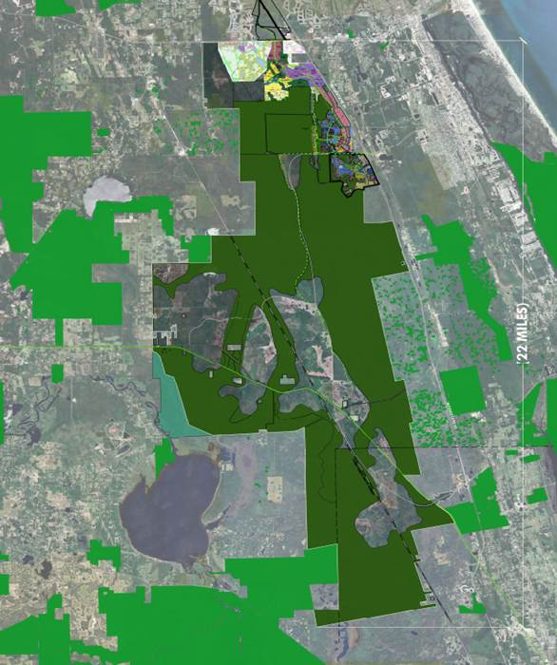
DEERING PARK INNOVATION CENTER PUD MASTER DEVELOPMENT AGREEMENT
GOAL: MAINTAIN NATURAL VEGETATION AREAS, HABITAT CORRIDORS AND CONSERVATION EASEMENTS.
PUD requires that a minimum of 400 acres of natural vegetation areas will be maintained and tied into the approximately 71 square miles of wildlife habitat corridor south of Deering Park Innovation Center.
The conservation easements for the natural vegetation areas will be layered with two or more beneficiaries to provide for perpetual conservation easements.

Slide 11
DEERING PARK INNOVATION CENTER PUD MASTER DEVELOPMENT AGREEMENT
The cost of maintaining the conservation easement areas and preventing invasive species shall be borne by Deering Park Innovation Center or the Community Development District or Stewardship District that will provide for perpetual maintenance.
A 50’ natural vegetation buffer is required along SR 44 to provide a viewshed and screen from traffic.

Slide 12
DEERING PARK INNOVATION CENTER PUD MASTER DEVELOPMENT AGREEMENT
GOAL: PLAN FOR A LIVE, WORK, AND PLAY COMMUNITY THAT ENCOURAGES REDUCTION IN NEED FOR AUTOMOBILE TRAFFIC.
The PUD provides a mixed-use community that requires bicycle and personal electric vehicle connections and to adjoining communities.
Although the community will be developed as a walkable, multi-modal friendly mixed-use development, there shall be no reduction in required parking as a result of the walkability and alternative transportation options.
The PUD provides for a commercial village to provide shopping, restaurant and entertainment to the area west of I95 to reduce traffic east of I95.

Slide 13
DEERING PARK INNOVATION CENTER PUD MASTER DEVELOPMENT AGREEMENT
GOAL: PROVIDE A MEANS TO ENSURE COMPLIANCE WITH ALL PUD OBLIGATIONS DURING STAFF REVIEW OF EVERY PROJECT WITHIN DEERING PARK INNOVATION CENTER.
The PUD provides that the Owner agrees to work with the staff to prepare a standard checklist of all PUD requirements to allow staff to review and confirm compliance for every new plat or site plan to ensure that any construction is consistent with the requirements of the Deering Park Innovation Center PUD.
The PUD provides that copy of said checklist showing compliance with every requirement shall be part of the record for every plat or site plan review.

Slide 14
DEERING PARK INNOVATION CENTER PUD MASTER DEVELOPMENT AGREEMENT
GOAL: PROVIDE FOR RESILENCY AND SUSTAINABILTY.
The PUD provides for stormwater designs that will redirect unprecedented stormwater into areas to allow for recharge and restoration of wetlands.
The PUD provides that utility designs shall plan for such unprecedented storm events by hardening its infrastructure. All electrical service, internet service and key traffic signalization are required to be placed underground at a safe depth to protect those lines from storm impacts.
The PUD provides that all construction shall adhere to higher standards to accomplish water and energy efficiency and conservation.
The PUD provides that a minimum of 50% of the site will be open space.

Slide 15
DEERING PARK INNOVATION CENTER PUD MASTER DEVELOPMENT AGREEMENT
The PUD provides that Deering Park Innovation Center shall utilize the Sustainable Floridians Certification and Monitoring Program (SF CAMP), developed by the University of Florida, as may be amended from time to time.
The PUD provides that all landscape plant materials shall be either Florida native species or Florida Friendly plant material to reduce or eliminate the need for irrigation and replanting.
The PUD provides that planning for colors for buildings shall include the consideration of the use of higher light reflective values for paint and roofing materials.
The PUD provides that residences will meet the Energy Star program standards.

Slide 16
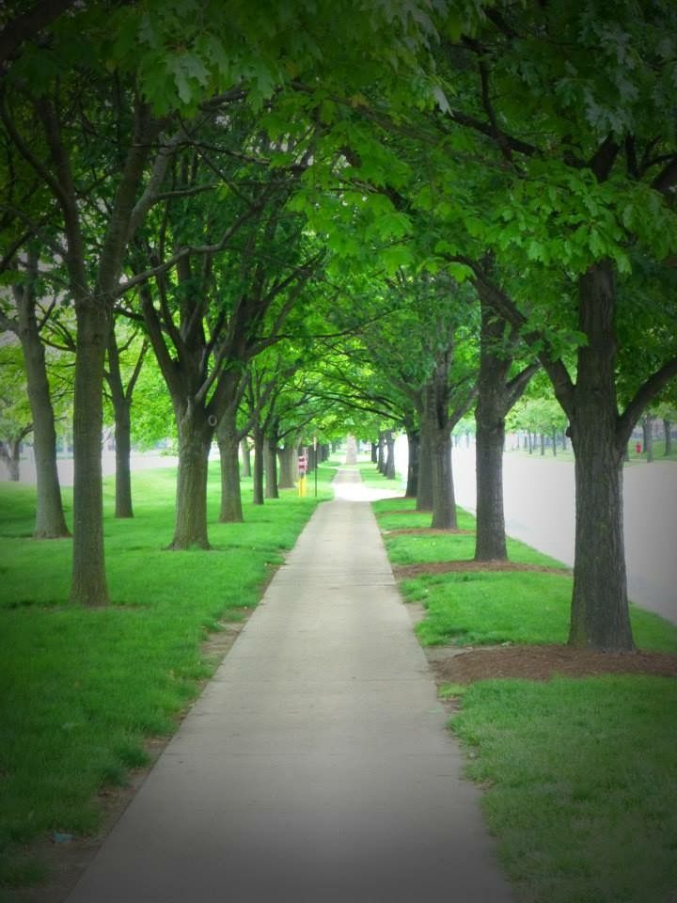
DEERING PARK INNOVATION CENTER PUD MASTER DEVELOPMENT AGREEMENT
The PUD provides that the plan shall encourage the planting of shade trees along pedestrian paths as protection from the sun
The PUD provides the stormwater management system lakes shall encourage dual use of the lakes by allowing the lakes to also be used as amenities.
The PUD provides that the stormwater management system shall be designed to provide habitat by providing for the planting of a minimum of 50% of the slopes in appropriate native vegetation and the creation of vegetated littoral shelves within no less than 25% of the shoreline of the stormwater management system lakes.

